Slide 1
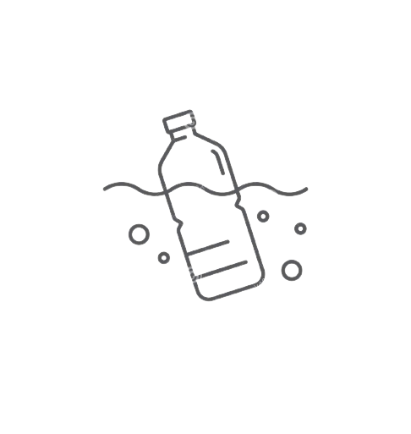
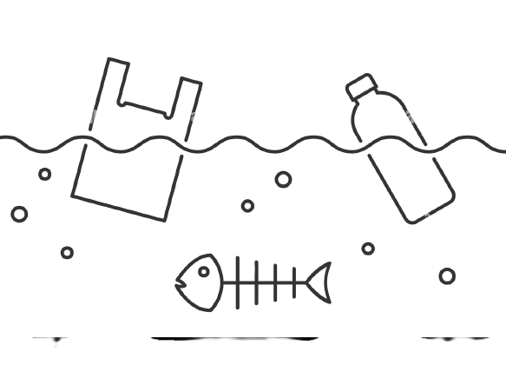
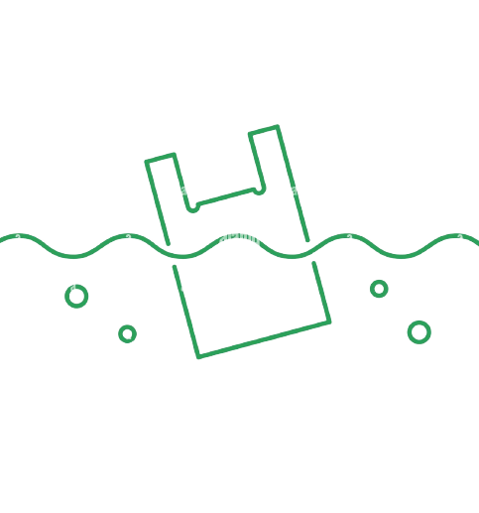
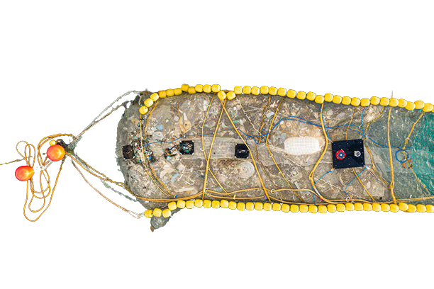
CCMN 432 (Sec 310) - F2022
Assignment #4: ORAL Presentation
System 002
Prepared By: Hamza Malik
Prepared For: Prof. Nubla
Date: Thurs, Dec 8, 2022
Source: The Ocean Cleanup

Slide 2
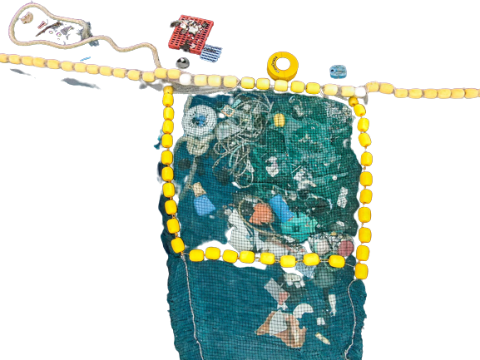


AGENDA
1.0 Speaker’s Bio
2.0 Problems and Purpose Statement
3.0 Perspective # 1: Background
4.0 Perspective # 2: Advantages
5.0 Perspective # 3: Disadvantages
6.0 Conclusion
References

Slide 3

1.0 Speaker Bio
Name: Hamza Malik
Position: Lead Engineer
Experience:
MASc Environmental Science & Engineering
1 Years Marine Engineer at Ocean Networks Canada
2 Years Environmental Officer at SeaBlue Canada
1 Years Project Coordinator at SeaBlue Canada
3 Years Lead Engineer at the Ocean Ambassadors Canada
Source: Canva.com

Slide 4
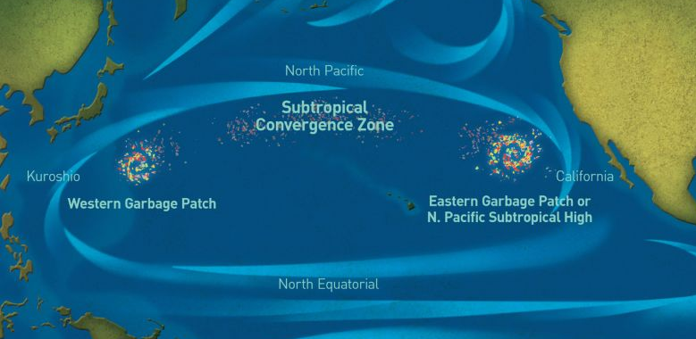
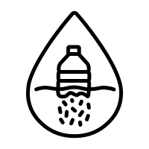
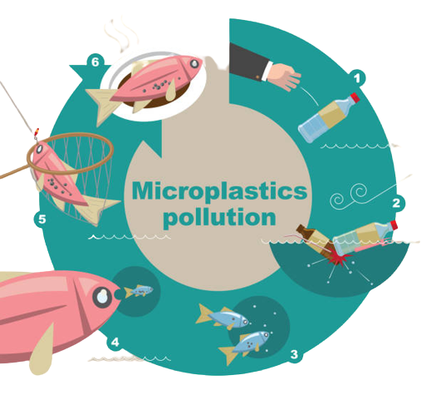
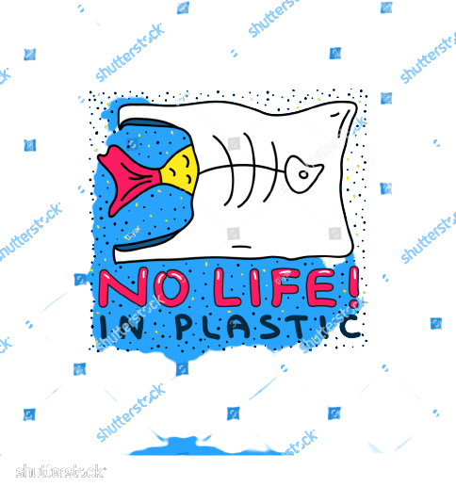
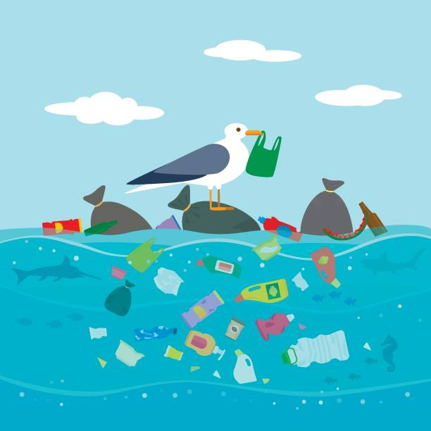
2.0 PROBLEM
The Great Pacific Garbage Patch:
1.6 Million Square Kilometers
1.8 trillion pieces of Plastic, microplastic, and marine debris roughly about 79,000 metric tons accumulate in The Great Pacific Garbage Patch (National Library of Medicine, 2018).
Source: National Geographic Society
Source: istock
Source: Shutter Stock
Non Biodegradable
Source: istock

Slide 5

Purpose Statement
The purpose of the final report is to evaluate System 002, a large-scale cleanup technology to help reduce the marine debris and floating plastic accumulated within The Great Pacific Garbage Patch.

Slide 6
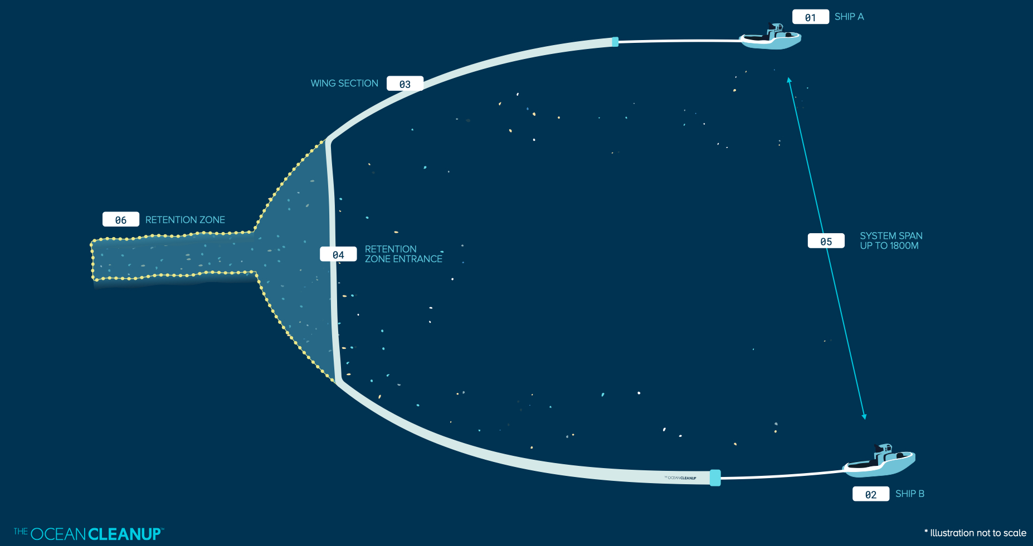
2.1 Background
Figure 1. Prototype of System 002. The numbers indicate the process by which the system works (The Ocean Cleanup, n.d.)

Slide 7
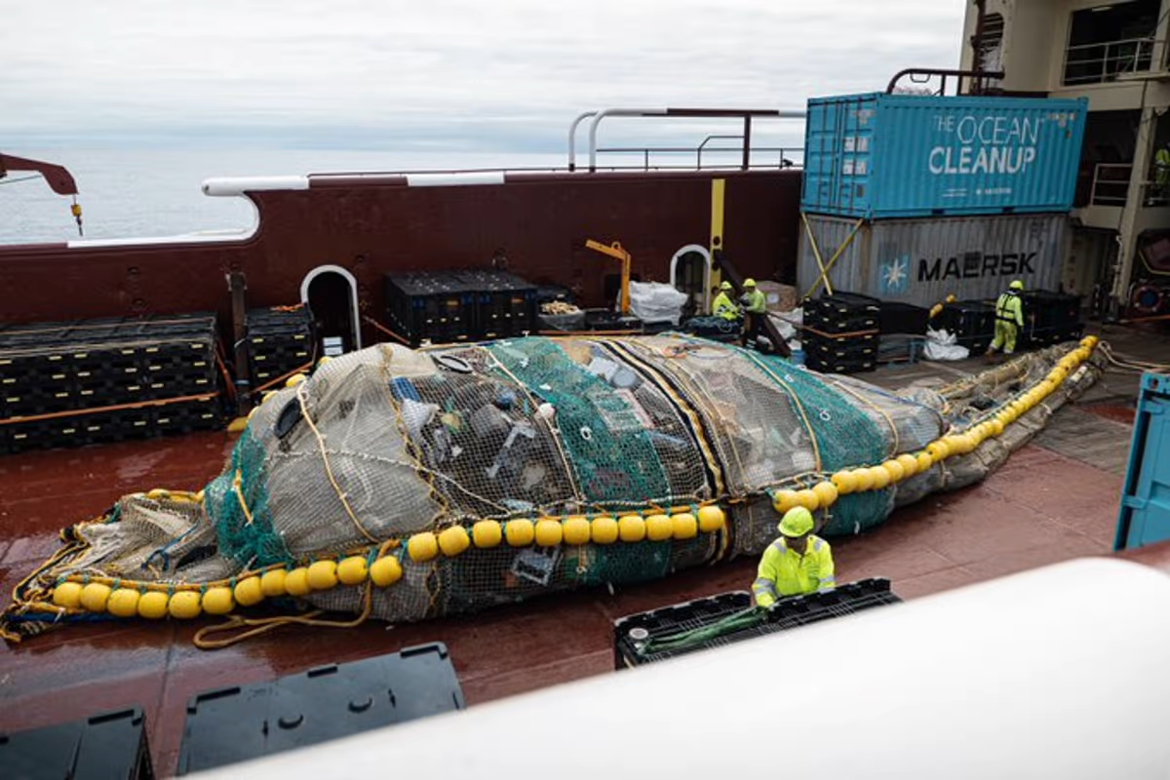

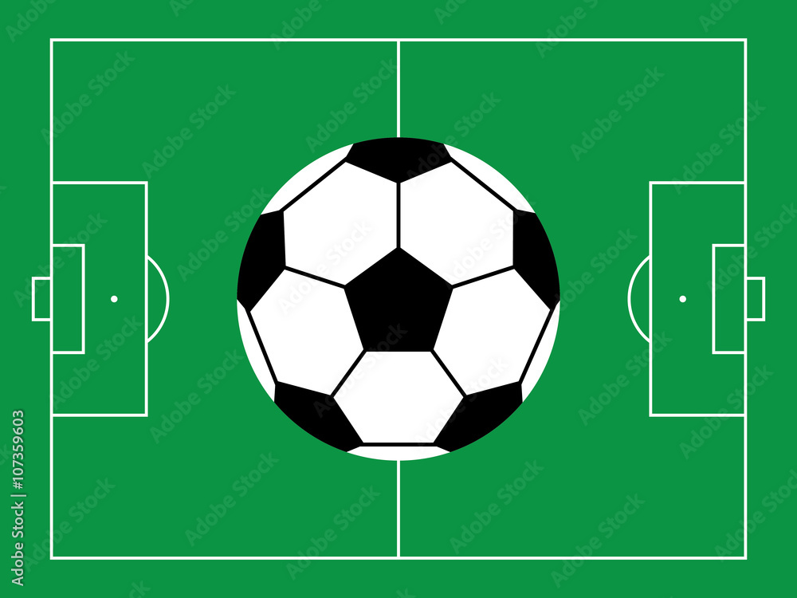



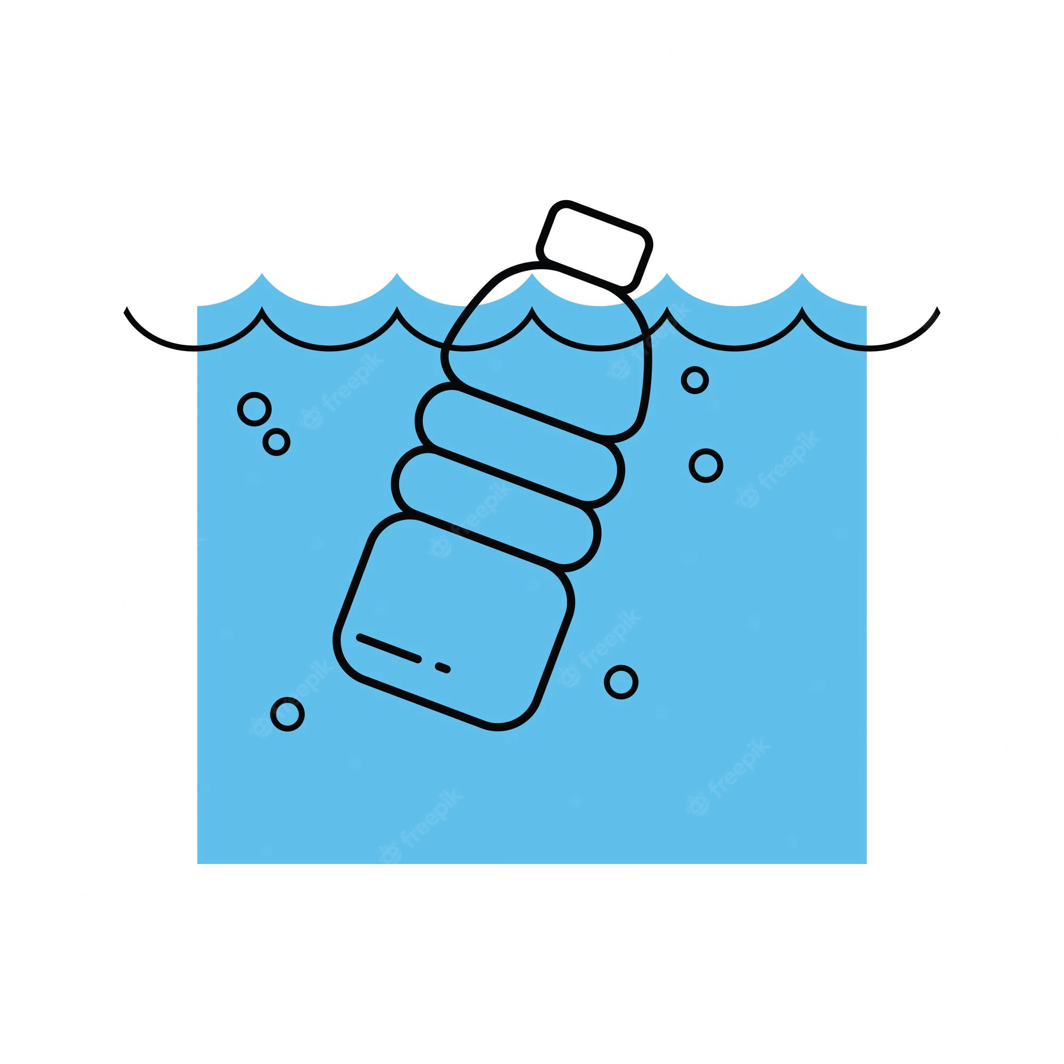
2.2 Advantages
Refined cleanups:
,
Enhanced systems:
Quick & Efficient Covers Larger Surface Area
Source: The Ocean Cleanup
Monitored conditions:
Collects upto
1000 kg/day
Since 2021
over 169,000 kg of marine debris Removed from the Ocean.
Easy System Suspension
(The Ocean Cleanup, n.d.)
(The Ocean Cleanup, n.d.)

Slide 8

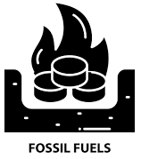
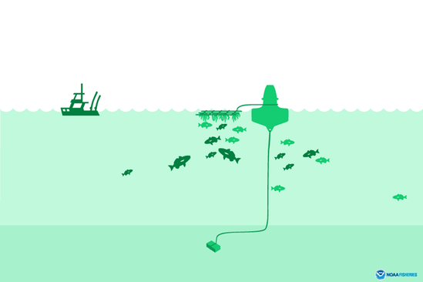

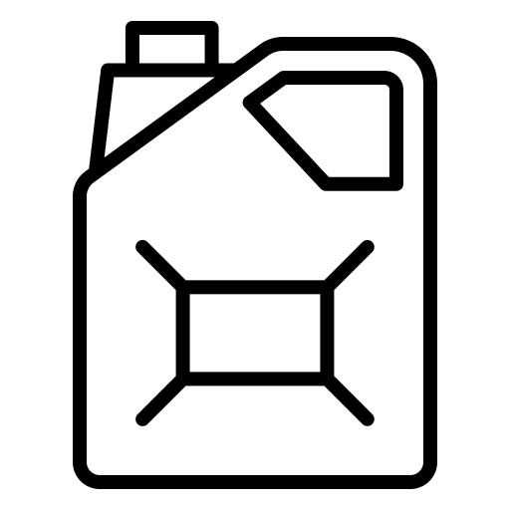

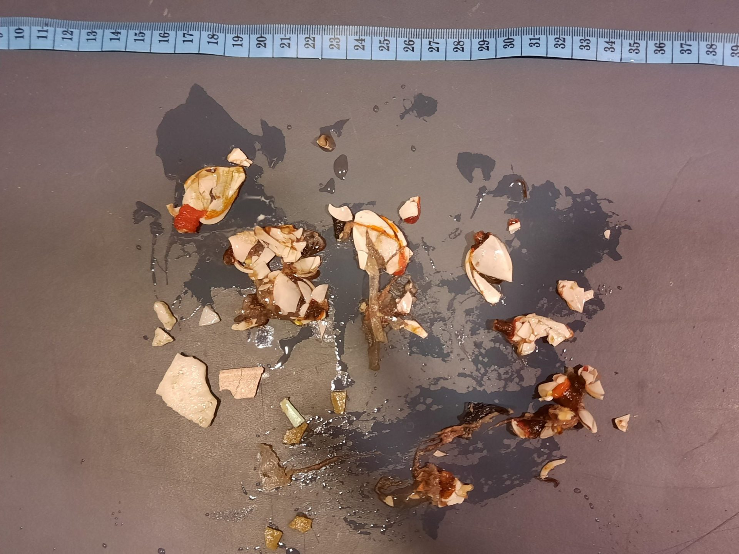
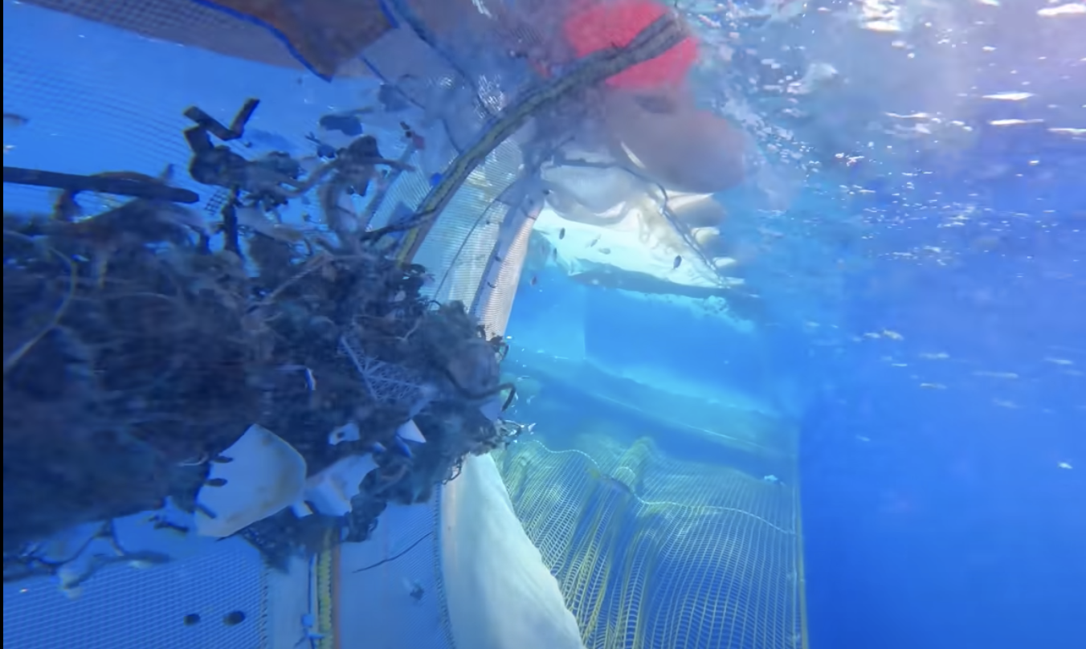
2.3 Disadvantages
Environmental Impacts:
,
Floating structural Impacts:
Fish Aggregating Device Effect
Entire System must be Disposed every Four Weeks
But Study Suggests:
Marine life Impacts:
Ocean Plastic
Marine Diesel
Extensive Plastic Exposure
Hydrothermal Liquefaction (Coxworth, 2011)
(The Ocean Cleanup, 2022)
(The Ocean Cleanup, 2021)

Slide 9
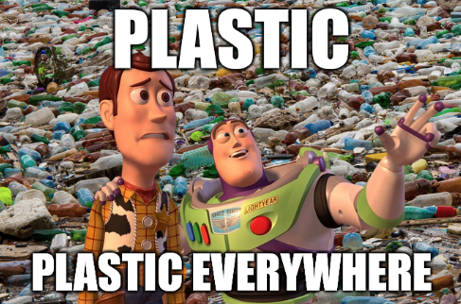

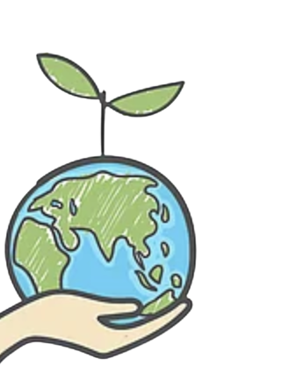

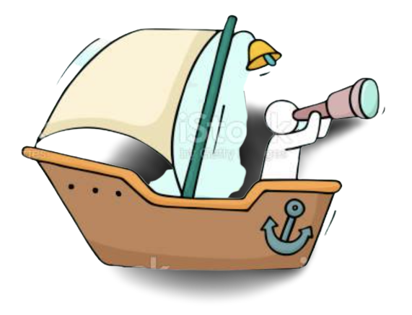
Conclusion
Multi-systems on deck and the conversion of ocean plastic into Marine Diesel will reduce travel time and be more environmentally friendly (Lavars, 2021).
System 002 will be an effective solution in reducing 1.8 trillion pieces of plastic from The Great Pacific Garbage Patch (National Library of Medicine, 2018).
,
Marine life can get trapped in the retention zone, cameras and crew members will be on guard to prevent it (The Ocean Cleanup, 2022).

Slide 10
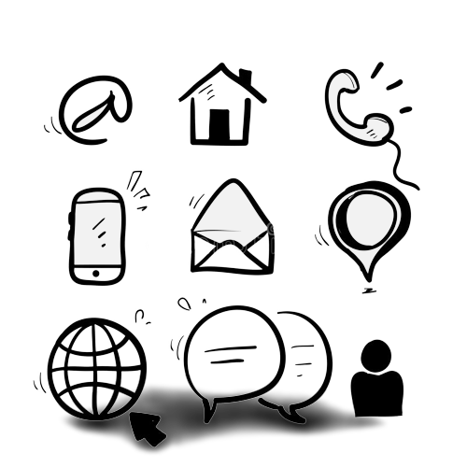
Thank Your For
Your Time!
I can be reached at:
Email: hamzamalik@oceanambassadors.gc.ca
Phone: (604) 639-2530 ext 1400

Slide 11
References
CNET. (2021, November 2). The Ocean Cleanup begins cleaning the Great Pacific Garbage Patch.
https://www.youtube.com/watch?v=tLcnJEMnlTs
Coxworth, B. (2011, July 5). The plastic2Oil process turns plastic waste into fuel. New Atlas. https://newatlas.com/plastic2oil-converts-plastic-to-fuel/19108/?itm_source=newatlas&itm_medium=article-body
Designboom. (2021, October 12). the ocean cleanup tests its massive system 002 to great success.
Designboom | Architecture & Design Magazine.
https://www.designboom.com/technology/the-ocean-cleanup-system-002-test-10-12-2021/
Haro, A. (2021, November 3). The Ocean Cleanup Crew Just Proved That System 002 Works. The Inertia. https://www.theinertia.com/environment/the-ocean-cleanup-crew-just-proved-that-system-002-two-works/
Lavars, N. (2021, November 3). Can ocean cleanup boats power themselves by turning plastic into fuel? New Atlas. https://newatlas.com/environment/ocean-cleanup-boats-plastic-blue-diesel-fuel/
National Library of Medicine. (2018, March 18). The Great Pacific Garbage Patch counts. https://www.ncbi.nlm.nih.gov/search/research-news/4120/#:~:text=The%20Great%20Pacific%20Garbage%20Patch%20counts%201.8%20trillion%20pieces%20of

Slide 12
Newton, M. (2022, January 31). Is the Ocean Cleanup Back on Track? New System Starts Cleaning Up the Pacific Trash Patch. Digital for Good | RESET.ORG. https://en.reset.org/is-the-ocean-cleanup-back-on-track-new-system-starts-cleaning-up-the-pacific-trash-patch/
NOAA FISHERIES. (2017, November 30). Fishing Gear: Fish Aggregating Devices | NOAA Fisheries. https://www.fisheries.noaa.gov/national/bycatch/fishing-gear-fish-aggregating-devices#:~:text=Fish%20aggregating%20device.
Plastic pollution coalition. (2022, May 16). What Really Happens To Your Plastic “Recycling.” https://www.plasticpollutioncoalition.org/blog/2022/5/16/what-really-happens-to-your-plastic-recycling#:~:text=From%20a%20recycling%20bin%2C%20plastics
The Ocean Cleanup. (2022, January 10). System 002: Mid-Term Evaluation • Updates • The Ocean Cleanup. https://theoceancleanup.com/updates/system-002-mid-term-evaluation/
The Ocean Cleanup. (n.d.). System 002 • Milestones • The Ocean Cleanup. The Ocean Cleanup. Retrieved October 31, 2022, from https://theoceancleanup.com/milestones/system-002/#:~:text=System%20002%20is%20our%20first
The Ocean Cleanup. (n.d.). Will the systems have a Fish Aggregating Device (FAD) effect? • FAQs • The Ocean Cleanup. The Ocean Cleanup. Retrieved November 23, 2022, from
https://theoceancleanup.com/faq/will-the-systems-have-a-fish-aggregating-device-fad-effect/

